Slide 1


Nischay Rughubeer
30th July 2025

Slide 2

Outline
Executive Summary
Introduction
Methodology
Results
Conclusion
Appendix

Slide 3
Executive Summary
For this data science project various methodologies and data analysis were used to obtain analytical results. The following methodologies were used in this project:
Data collection
Data wrangling
Exploratory data analysis
Data visualization
Model development and predictive analysis
This allows us to have a through analysis and investigation to see the main factors that determine the outcome and make predictions

Slide 4
Introduction
For this data science project, I am tasked to work in the role of a data scientist working for a rocket company called SpaceY. SpaceX advertises the Falcon 9 rocket launches on its website with a cost of 62 million dollars whilst other providers cost upward of 165 million dollars. This is because SpaceX can reuse the first stage if it can land safely. Therefore, the purpose of this project is to analyse what it takes for the first stage to land. This can therefore be used if an alternate company wants to bid against SpaceX for a rocket launch.

Slide 5

Section 1

Slide 6
Methodology
Data collection methodology API:
Utilised launch data from open source REST API from SpaceX
Data was filtered to only Falcon 9
Payload mass missing values replaced with the mean
Data was scraped using requests from Falcon 9 and Falcon Heavy Launches Records from Wikipedia using Wikipedia URL
Table was parsed using HTML parser and converted into a pandas dataframe
Perform data wrangling:
Data was transformed for analysis, for example the outcome of a successful landing was labelled as 1 and if not 0.
Perform exploratory data analysis (EDA) using visualization and SQL
Perform interactive visual analytics using Folium and Plotly Dash
Perform predictive analysis using classification models
Utilised varioys types of prediction models (Logistic regression, support vector machine, decision tree classifier, and knn)
Data was split into test and training sets to determine best hyperparameter

Slide 7
Data Collection
There were 2 methods that were used for data collection in this project, and they are the following:
SpaceX REST API
Web scraping

Slide 8
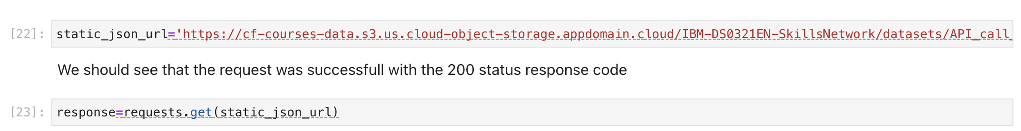
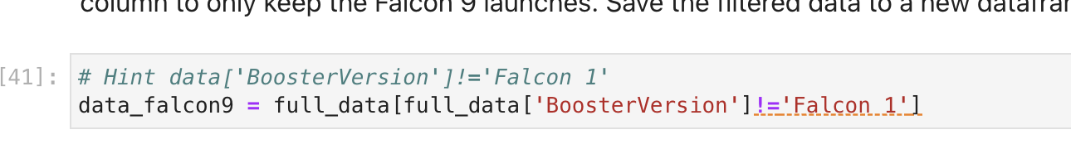
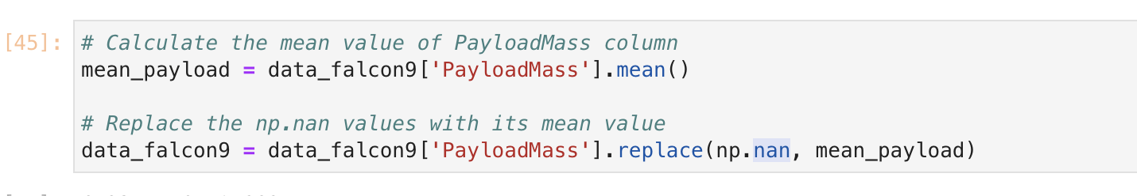
Data Collection – SpaceX API
For this a get request was made to obtain data from the Space X open source API.
Only utilised the columns of data that were necessary from the project and filtered data for Falcon 9
The missing values from the payload mass column were replaced with the mean value of the column
GitHub URL provided in the Appendix

Slide 9
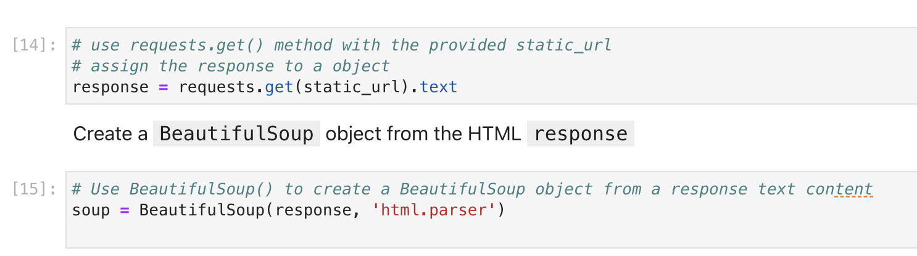
Data Collection - Scraping
The second method of data collection used was data scraping
The Data was scraped from the Falcon 9 and Falcon Heavy Launches Records from Wikipedia using Wikipedia URL
Extracted the information needed by parsing the table using HTML parser and converting it into a pandas data frame
GitHub URL provided in the Appendix

Slide 10
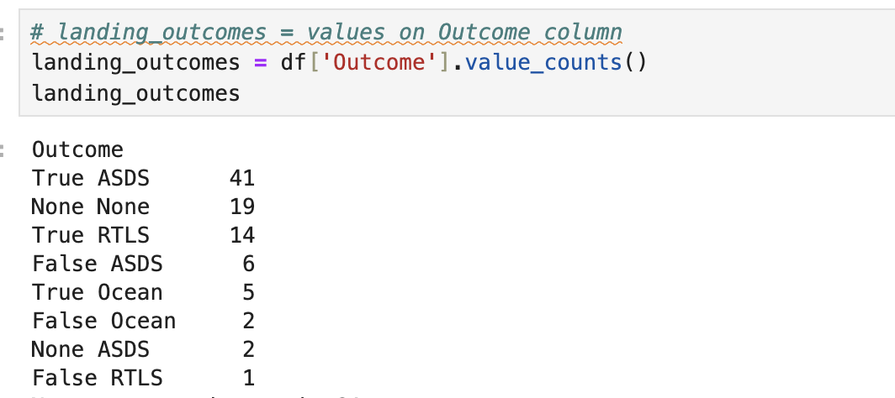
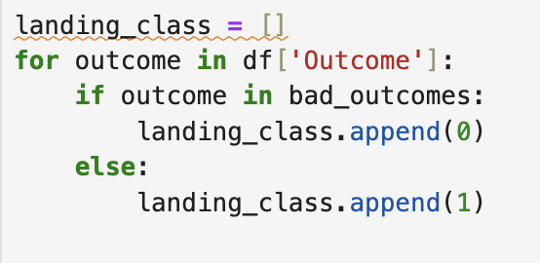
Data Wrangling
Utilised Data Wrangling to find any patterns in the data and determine the required labels for training supervised models
Since there was multiple outcomes in the data, an outcome class was made where “1” represents successful landing and “0” means failed landing.
To do this the number of successful outcomes was found based on orbits and a class of outcomes was to represent whether it was a success or not

Slide 11
EDA with Data Visualization
Used Matplotlib and seaborn to visualisation libraries for the plots
The following plots were made to determine the relationships between variables to gain insight on what factors were to be crucial in the success of the first landing:
Flight Number vs Payload Mass
Flight Number vs Launch Site
Payload Mass vs Launch Site
Orbit type success rate
Flight Number vs Orbit type
Payload Mass vs Orbit type
Year success rate

Slide 12
EDA with SQL
Utilised SQL queries to get lists of information that could be crucial in this investigation. These were the following:
Names of the unique launch sites using SELECT DISTINCT
Average Payload Mass using SELECT AVG
Successful Booster versions using SELECT
Mission Outcomes using SELECT, COUNT and GROUP BY

Slide 13
Build an Interactive Map with Folium
Used Python mapping library Folium to display Launch Sites on the map.
These maps had the launch sites marked, the successful and failed landing areas for each site and its distances to its surroundings
This was done to see what areas would be the most success and the distances that would be of the most success

Slide 14
Build a Dashboard with Plotly Dash
Plotly dash was used to creative an interactive dashboard so that users can adequately explore the data
The plots used and can be manipulated by the user (where data can be investigated for all sites or individual sites) to explore were the following:
Pie chart for the success rate
Scatter plot for Payload Mass vs Landing outcome

Slide 15
Predictive Analysis (Classification)
Used predictive analysis to predict whether the first launch will land successfully or not
Before data can be used in the model it needed to be standardised, have the correct training lables (class outcome) and split into test data and training data
Once this was done 3 model types and respect optimal hyperparameters using cross validated grid search were found for each:
Logistic Regression
Support Vector Machine
Decision Tree Classifier
Accuracy on test data was used to evaluate the models

Slide 16

Section 2

Slide 17
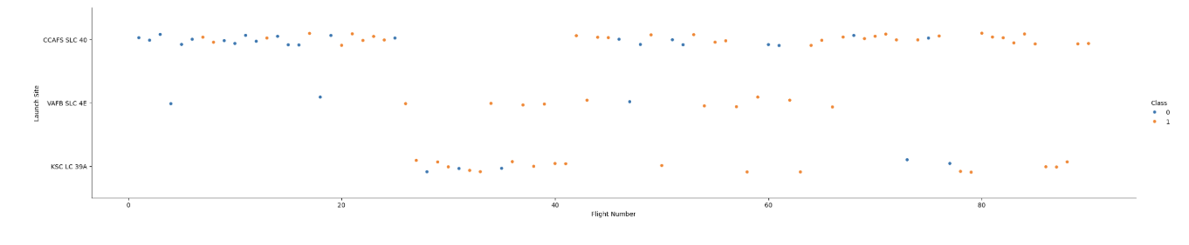
Flight Number vs. Launch Site
For this plot 0 represented a failed landing and 1 represented a successful landing. From this graph we can tell that most of the launches came from CCAFS SLC 40. This is also the site that had the most successful landings. However, one point to notice is that it also has the most failures due to the proportions of launches compared to the other 2 sites as well.

Slide 18
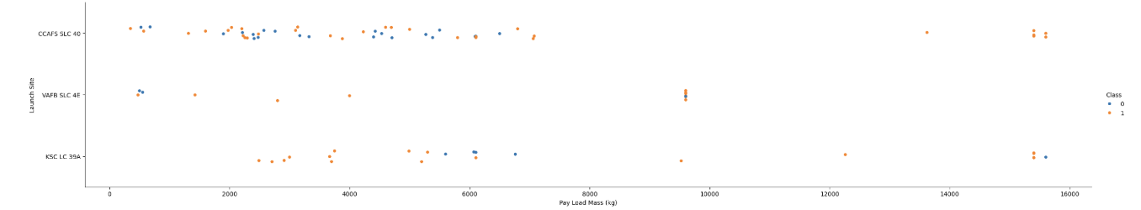
Payload vs. Launch Site
For this plot 0 represented a failed landing and 1 represented a successful landing. From the plot we can tell that most launches had a payload mass of less than 8000 kg, where most successful landings happen compared to successful landings. However, when the payload mass exceeds 8000 kg, whilst there are fewer data points, the proportion compared to successful landings and failed landings weigh heavier to successful when compared with the proportion of success and failure on data points with payload mass less than 8000 kg

Slide 19
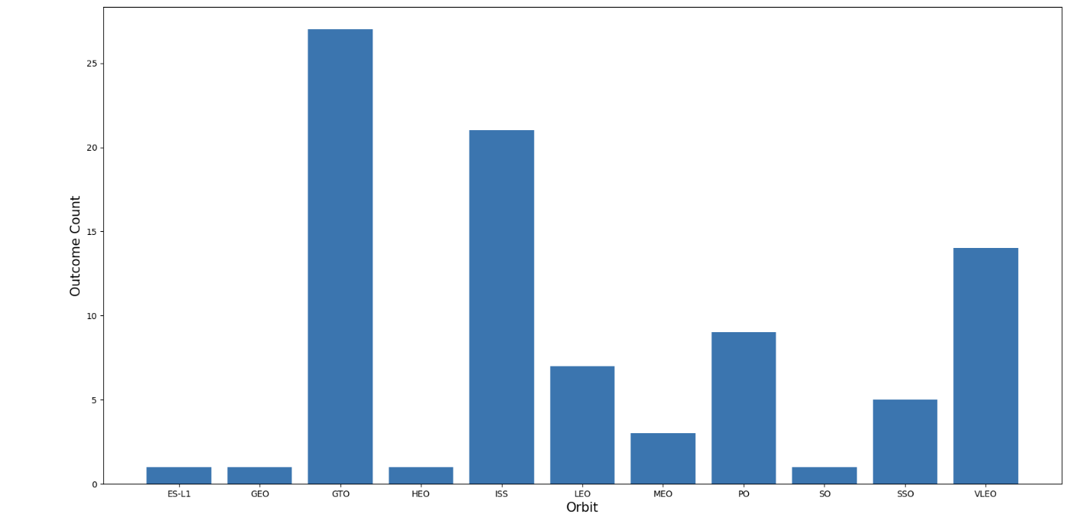
Success Rate vs. Orbit Type
From this plot we can see that the most successful orbit types come from GTO (geosynchronous orbit high orbit) and ISS (low orbit) and the least successful have an orbit type of ES-L1 (small object orbit at the equilibrium of gravitational force between two large bodies, earth and sun), GEO (circular geosynchronous orbit), HEO (highly elliptical orbit) and SO (sun-synchronous orbit).
This shows that the most successful orbit type is the geosynchronous high orbit that matches the earths rotation.

Slide 20
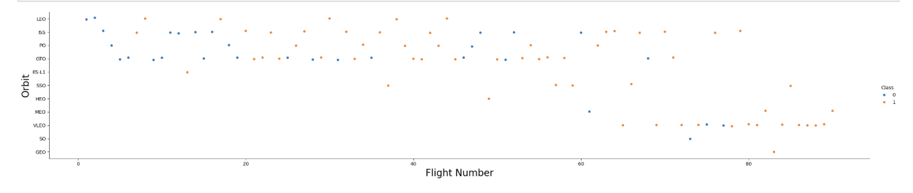
Flight Number vs. Orbit Type
For this plot 0 represents a failed landing and 1 represents a successful landing. As we can see from this plot that the majority of launches went into GTO orbit type and supports the data from the previous slide that GTO orbit has the most successful landings. However, it is worth noting that whilst GTO had the most success cases, this plot displays that the VLEO orbit type seems to have a higher ratio of success to failed landings. More data would be needed to determine whether it would be a better orbit type than GTO.

Slide 21
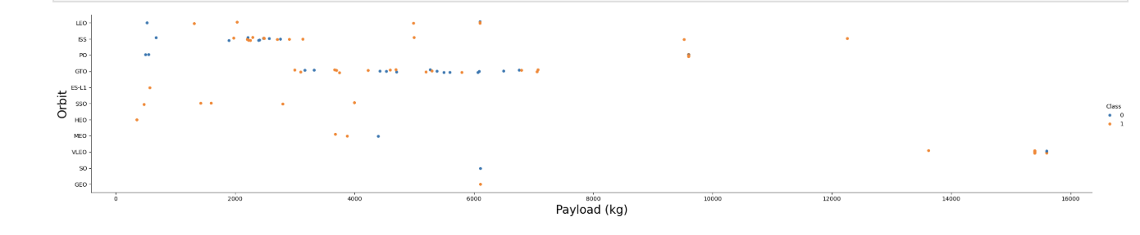
Payload vs. Orbit Type
For this plot 0 represents a failed landing and 1 represents a successful landing. As the plot shows most launches have a payload mass of less than 8000 kg. Additionally, the most densely populated region of successful landings seem to happen in the region of 2000 kg to 6000 kg.

Slide 22
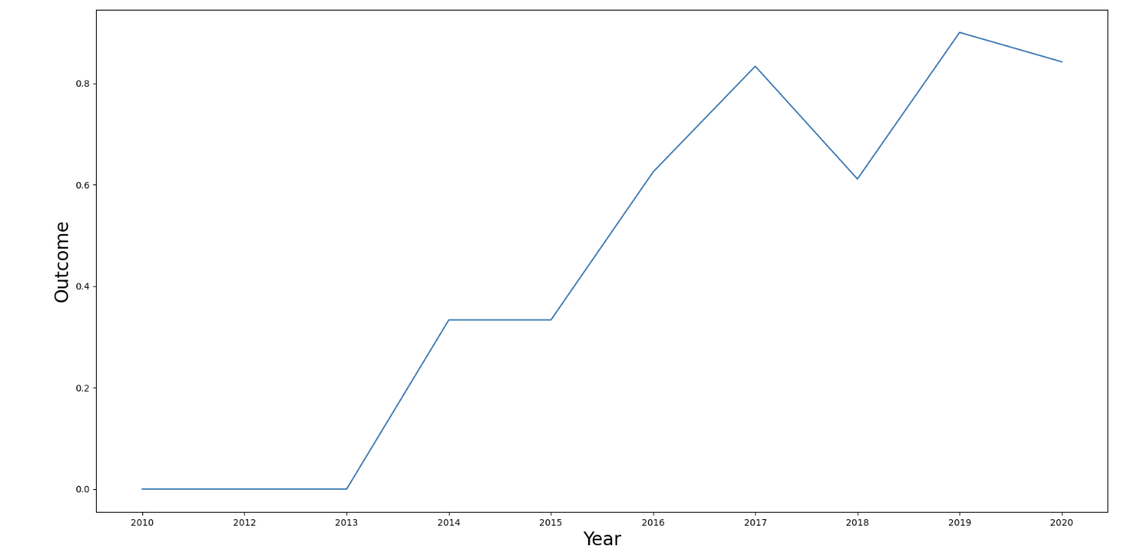
Launch Success Yearly Trend
From this plot, we can tell that overall, the success rate is increasing over the years. However, there is a dip between 2017 but a drastic increase to bring it back to a positive from between 2018 and 2019 and peaking at over 0.8. Although, from the last data set from 2019 to 2020 it appears that the success rate is on a downward trend.

Slide 23
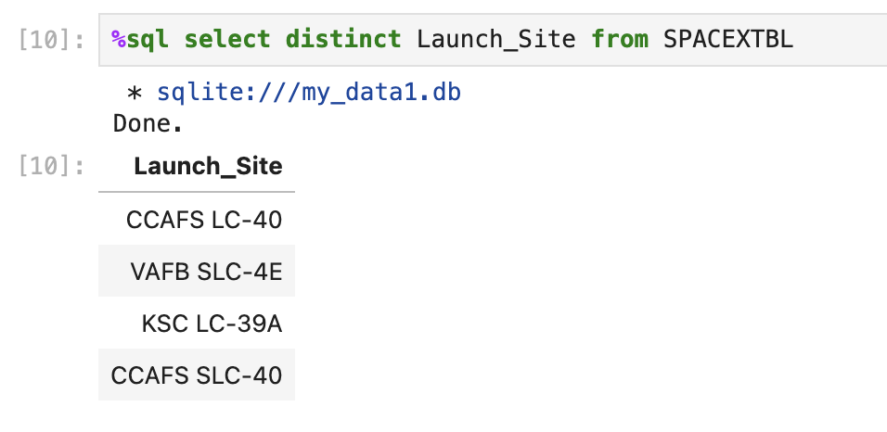
All Launch Site Names
The SQL query SELECT DISTINCT was used to be able to obtain all the launch sites that SpaceX used without there being duplicated values.

Slide 24
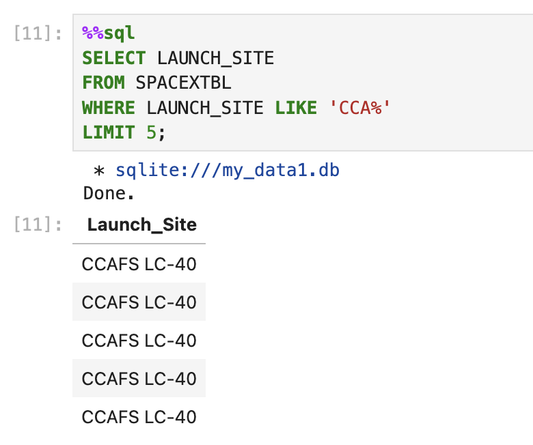
Launch Site Names Begin with 'CCA'
The SQL query SELECT was used to specify launch site, where condition was put into to specify that I wanted launches that started with ‘CCA’ and used ‘%’ to indicated any letters or symbols after. Additionally, the LIMIT clause was used to limit to 5 records

Slide 25
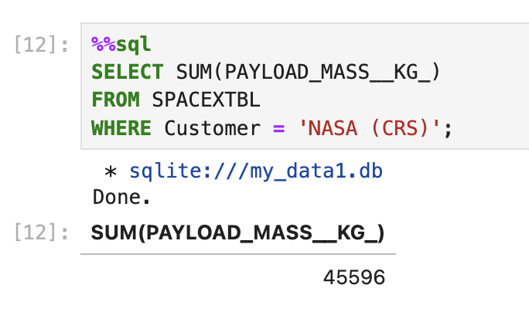
Total Payload Mass
A SELECT SUM SQL query was used to find the total payload mass used by NASA (CRS)

Slide 26
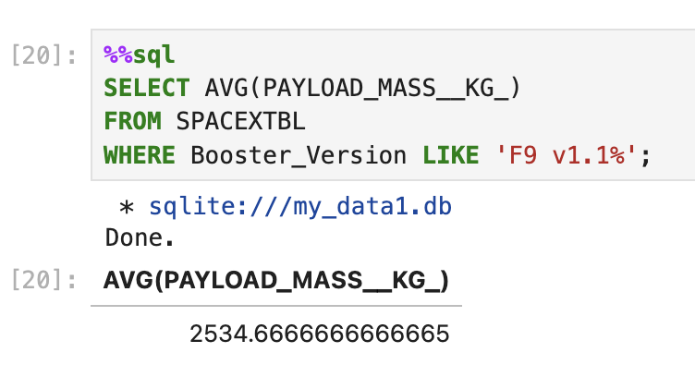
Average Payload Mass by F9 v1.1
A SQL SELECT AVG query was used to determine the average payload mass. Additionally, a WHERE clause was used to specify that I wanted the average payload mass of the booster version F9 v1.1

Slide 27
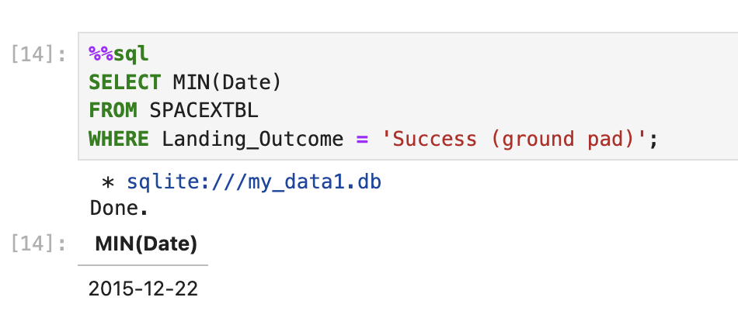
First Successful Ground Landing Date
Using SELECT MIN query along with a conditional to find when the first successful launch was.

Slide 28
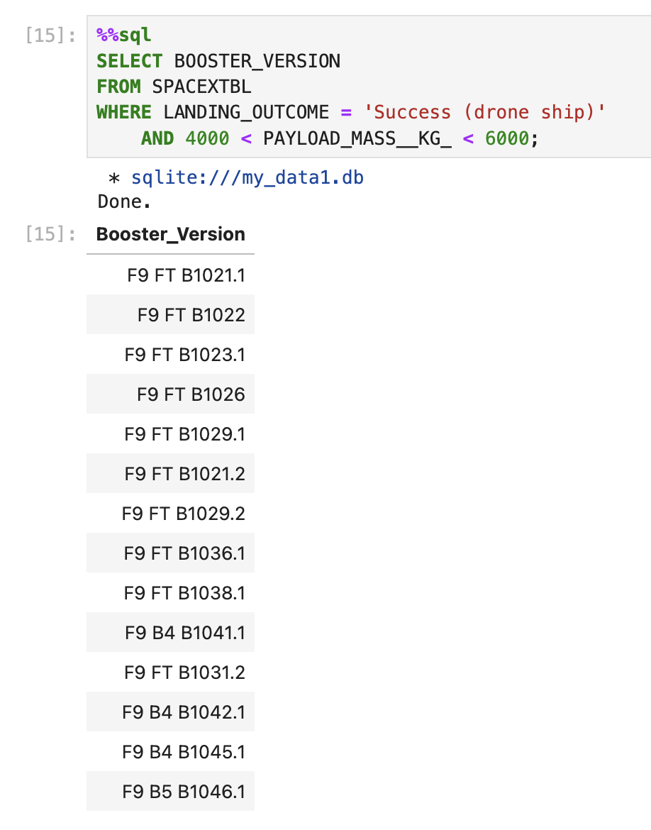
Successful Drone Ship Landing with Payload between 4000 and 6000
Using SELECT query along with a conditional of the payload mass being between 4000 kg and 6000 kg. Additionally, there is a condition added to provide the data to be only based on successful landings.

Slide 29
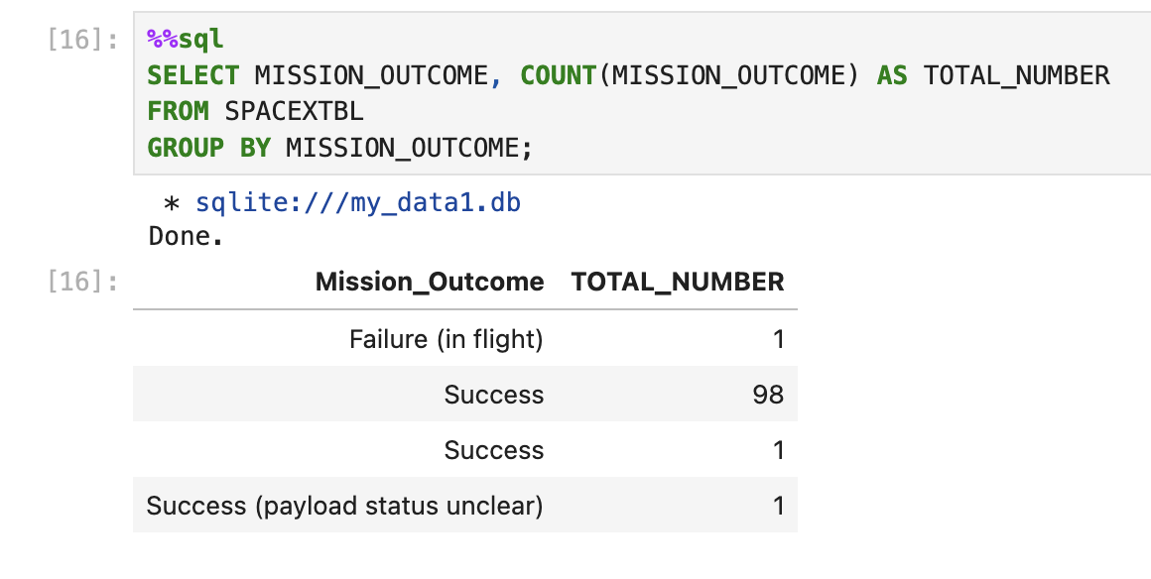
Total Number of Successful and Failure Mission Outcomes
Using SELECT and COUNT query to find all the fields of the specific mission outcomes. The information was grouped by mission outcome and saved in the column TOTAL_NUMBER to display the total number of successful and failed missions.

Slide 30
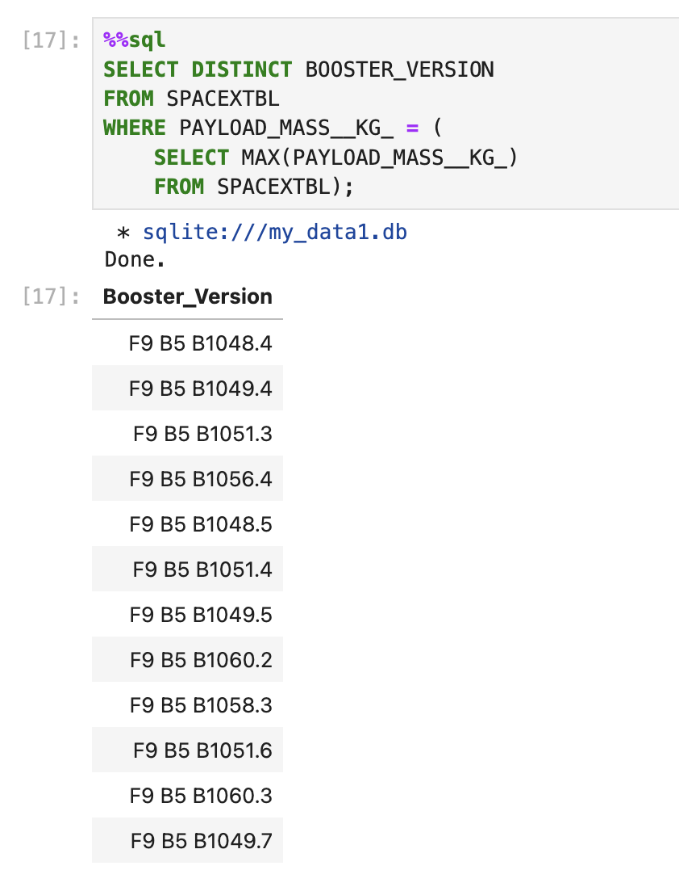
Boosters Carried Maximum Payload
Using SELECT DISTINCT query to find the distinct boosters without duplicates. To find the boosters that carried the maximum payload an aggregate function is used. The first condition is to find the specific payload mass and within that condition is a second condition for the maximum payload mass.

Slide 31
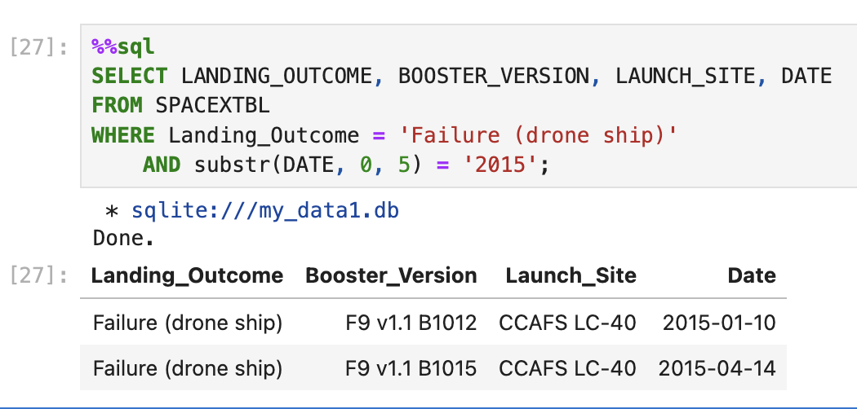
2015 Launch Records
Using SELECT query and two conditions to obtain the landing outcome, booster version, launch site, date of failed missions in the year 2015.

Slide 32
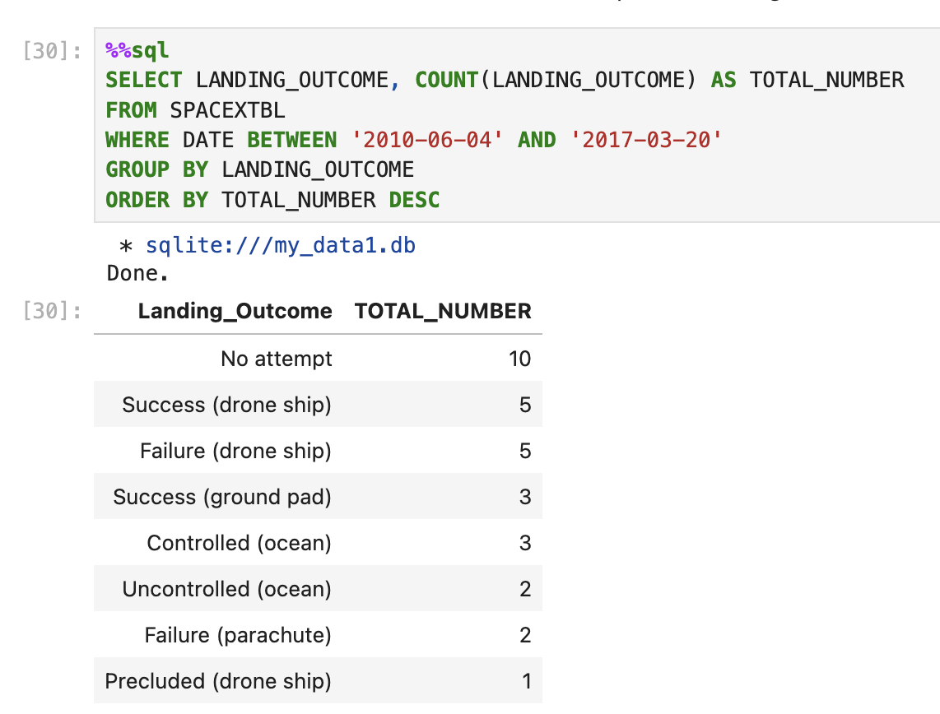
Rank Landing Outcomes Between 2010-06-04 and 2017-03-20
Using SELECT query, with a group by to group the count of landings types and an order by desc to order them from highest to lowest to see what are the most type of landings. This data was conditioned for the dates between 2010/06/04 and 2017/03/20.

Slide 33

Section 3

Slide 34
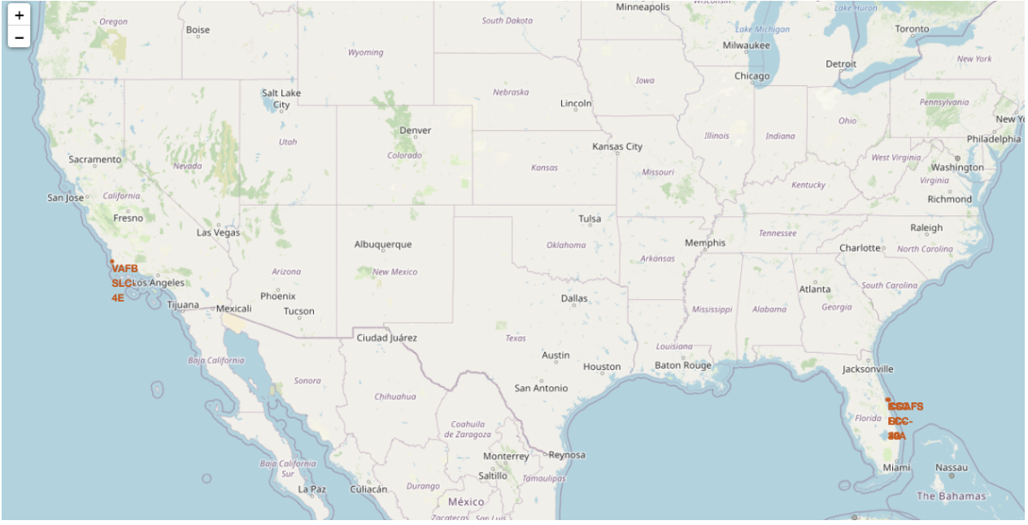
<Folium Map Screenshot 1>
Folium map produced of the launch sites. As the map shows, both launch sites are in proximity of the equator and are both located on the coast as well.

Slide 35
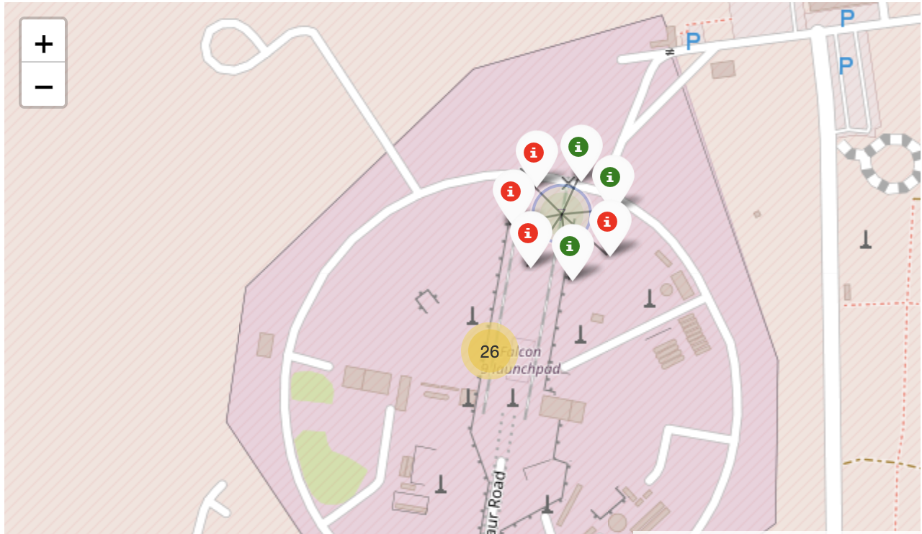
<Folium Map Screenshot 2>
Folium map to display the mission outcomes of the landing sites. As the map shows it displays the area of the landing site and additionally, has colour coded the number of successful landings with green and the number of failed landings with red.

Slide 36
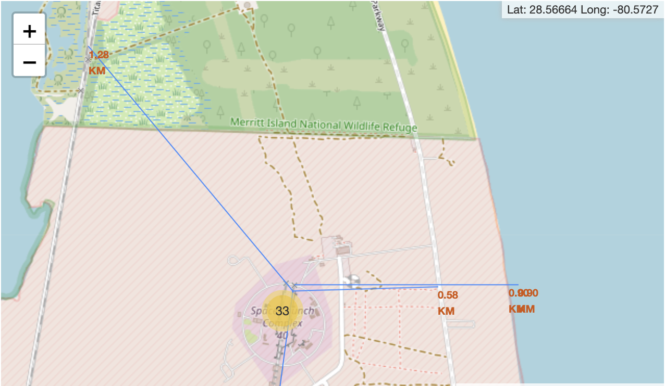
<Folium Map Screenshot 3>
As the map shows, the folium maps were produced where blue lines would display the distance launch sites are from the coastline, highways, and railways. The launch sites are closely located to railways and coastlines. I think this is to do with the transport of materials and in case of a bad landing then it is close to a large body of water. Additionally, the sites are far from highways and city to avoid any damage to the public.

Slide 37

Section 4

Slide 38
<Dashboard Screenshot 1>
Replace <Dashboard screenshot 1> title with an appropriate title
Show the screenshot of launch success count for all sites, in a piechart
Explain the important elements and findings on the screenshot

Slide 39
<Dashboard Screenshot 2>
Replace <Dashboard screenshot 2> title with an appropriate title
Show the screenshot of the piechart for the launch site with highest launch success ratio
Explain the important elements and findings on the screenshot

Slide 40
<Dashboard Screenshot 3>
Replace <Dashboard screenshot 3> title with an appropriate title
Show screenshots of Payload vs. Launch Outcome scatter plot for all sites, with different payload selected in the range slider
Explain the important elements and findings on the screenshot, such as which payload range or booster version have the largest success rate, etc.

Slide 41

Section 5

Slide 42
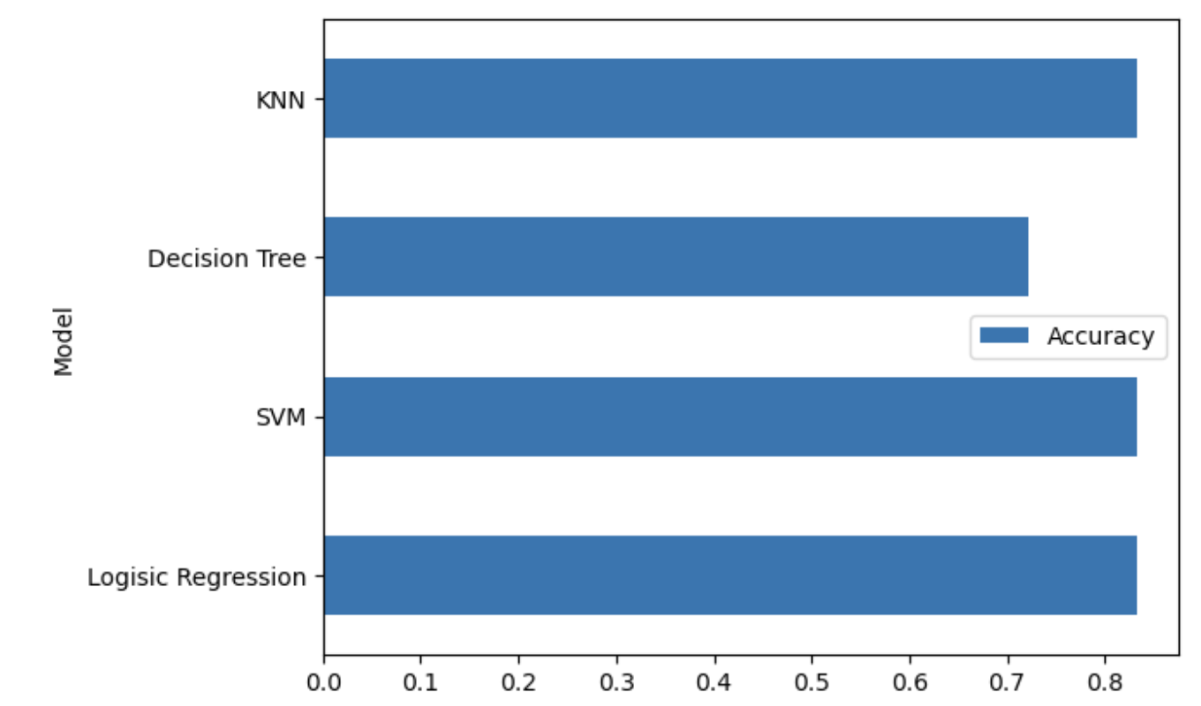
Classification Accuracy
As the bar chart shows, the calculated accuracy is weakest for the decision tree. However, for the KNN, SVM and Logistic Regression model, the accuracies have levelled off at roughly 0.83.

Slide 43
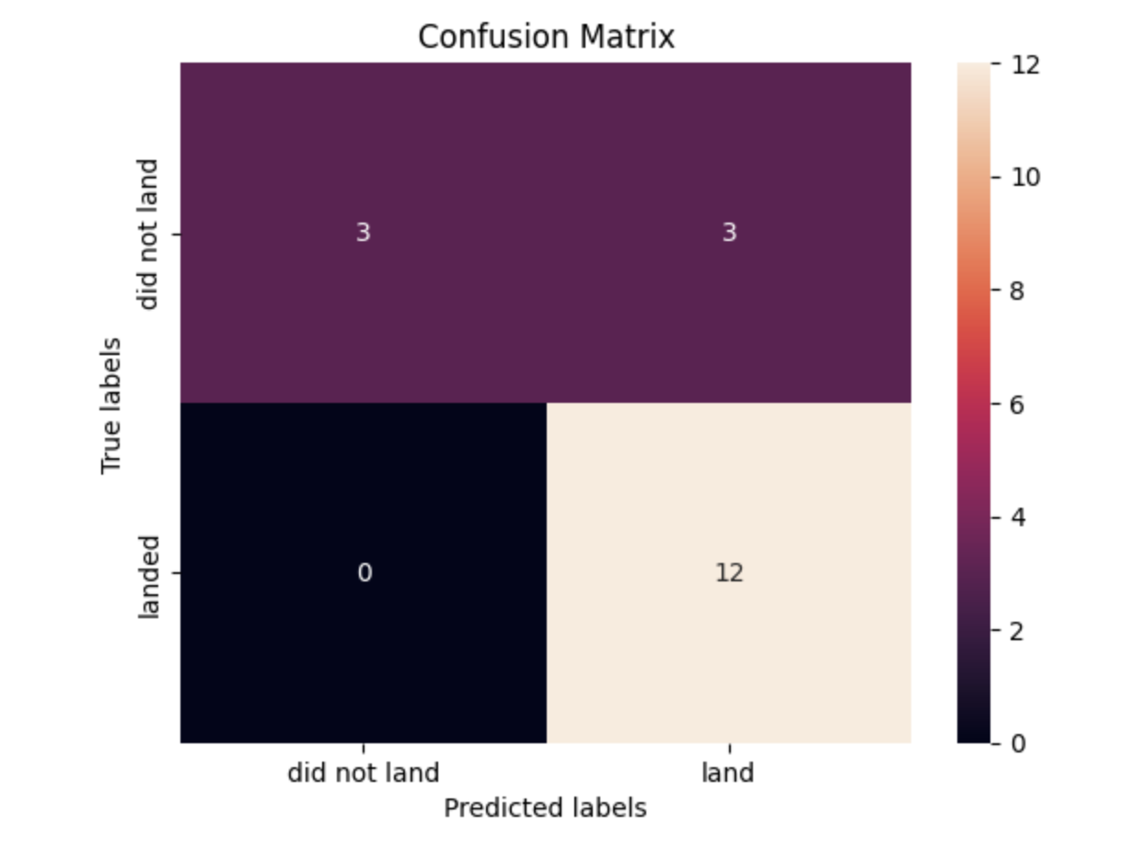
Confusion Matrix
The confusion matrix for the 3 best performing models tied with the same matrix. The decision tree model, the worst accuracy, had, instead of predicting all 12 correctly landed, predicted 10 correctly and 2 did not land incorrectly.
However, the confusion matrix to the right matched with the other three more accurate models. As the matrix shows the only problem it had with prediction was incorrectly classifying the land to be successful when it in actuality it did not land.

Slide 44
Conclusions
Using the prediction models produced we can predict if SpaceX first booster will land successfully with 83% accuracy.
From the yearly trend found, is has a negative correlation after 2019 therefore meaning the rate of successful landings decrease. However, the data was only up to 2020 and therefore the whole data set to the current time will be needed to get more of an accurate trend.
The lower the payload mass the more likely the booster is to successfully land.

Slide 45
Appendix
Include any relevant assets like Python code snippets, SQL queries, charts, Notebook outputs, or data sets that you may have created during this project

Slide 46


